Slide 1
Slides from the Text Book on Information Retrieval
Scoring, Term Weighting and the Vector Space Model

Slide 2
This lecture Agenda
Ranked retrieval
Scoring documents
Term frequency
Collection statistics
Weighting schemes
Vector space scoring

Slide 3
Boolean Retrieval - AND/OR/NOT
All documents
A
B
C

Slide 4
Boolean Retrieval
Weights assigned to terms are either “0” or “1”
  “0” represents “absence”: term isn’t in the document
  “1” represents “presence”: term is in the document
Build queries by combining terms with Boolean operators
  AND, OR, NOT
The system returns all documents that satisfy the query
Notes:
10

Slide 5
Ranked retrieval
Ch. 6
Thus far, our queries have all been Boolean.
  Documents either match or don’t.
Good for expert users with precise understanding of their needs and the collection.
  Also good for applications: Applications can easily consume 1000s of results.
Not good for the majority of users.
  Most users incapable of writing Boolean queries (or they are, but they think it’s too much work).
  Most users don’t want to wade through 1000s of results.
    This is particularly true of web search.

Slide 6
Problem with Boolean search: feast or famine
Ch. 6
Boolean queries often result in either too few (=0) or too many (1000s) results.
Query 1: “standard user dlink 650” → 200,000 hits
Query 2: “standard user dlink 650 no card found”: 0 hits
It takes a lot of skill to come up with a query that produces a manageable number of hits.
  AND gives too few; OR gives too many
Notes:
Cf. our discussion of how Westlaw Boolean queries didn’t actually outperform free text querying

Slide 7
Ranked retrieval models
Rather than a set of documents satisfying a query expression, in ranked retrieval, the system returns an ordering over the (top) documents in the collection for a query
Free text queries: Rather than a query language of operators and expressions, the user’s query is just one or more words in a human language
In principle, there are two separate choices here, but in practice, ranked retrieval has normally been associated with free text queries and vice versa

Slide 8
Feast or famine: not a problem in ranked retrieval
Ch. 6
When a system produces a ranked result set, large result sets are not an issue
  Indeed, the size of the result set is not an issue
  We just show the top k ( ≈ 10) results
  We don’t overwhelm the user
  Premise: the ranking algorithm works

Slide 9
Scoring as the basis of ranked retrieval
Ch. 6
We wish to return in order the documents most likely to be useful to the searcher
How can we rank-order the documents in the collection with respect to a query?
Assign a score – say in [0, 1] – to each document
This score measures how well document and query “match”.
Let us say we have a one-term query – How will you
Compute the score ?

Slide 10
Query-document matching scores
Ch. 6
We need a way of assigning a score to a query/document pair
Let’s start with a one-term query
If the query term does not occur in the document: score should be 0
The more frequent the query term in the document, the higher the score (should be)
We will look at a number of alternatives for this.
What are the two issues with the proposed approach

Slide 11
Take 1: Jaccard coefficient
Ch. 6
A commonly used measure of overlap of two sets A and B
What is jaccard(A,B) =
jaccard(A,B) = |A ∩ B| / |A ∪ B|
jaccard(A,A) = 1
jaccard(A,B) = 0 if A ∩ B = 0
A and B don’t have to be the same size.
Always assigns a number between X and Y and why?
Always assigns a number between 0 and 1 because
cause at most the intersection can be as large as the union.

Slide 12
Jaccard coefficient: Scoring example
Ch. 6
What is the query-document match score that the Jaccard coefficient computes for each of the two documents below?
Query: ides of march
Document 1: caesar died in march
Document 2: the long march

Slide 13
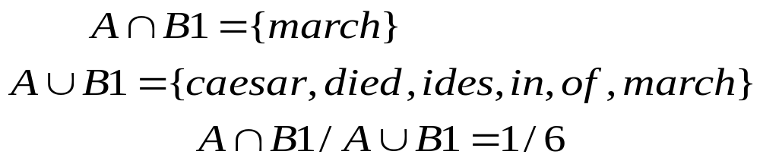
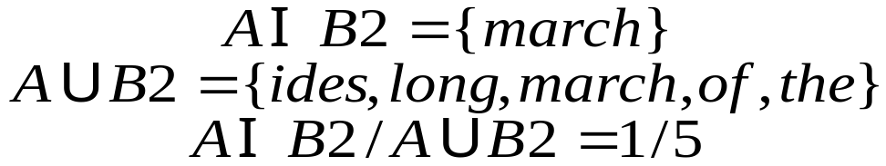
Jaccard Example
Query: ides of march
Document 1: caesar died in march
Document 2: the long march
A = {ides, of, march}
B1 = {caesar, died, in, march}
B2 = {the, long, march}

Slide 14
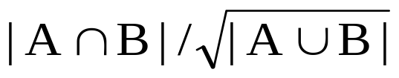
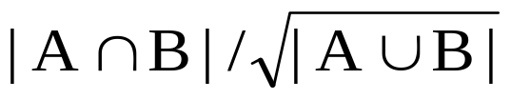
Issues with Jaccard for scoring
Ch. 6
It doesn’t consider term frequency (how many times a term occurs in a document)
Rare terms in a collection are more informative than frequent terms. Jaccard doesn’t consider this information
We need a more sophisticated way of normalizing for length
Later in this lecture, we’ll use
. . . instead of |A ∩ B|/|A ∪ B| (Jaccard) for length normalization.
WHY

Slide 15
The problem with the first example was that document 2 “won” because it was shorter, not because it was a better match. We need a way to take into account document length so that longer documents are not penalized in calculating the match score.

Slide 16

Recall (Lecture 1): Binary term-document incidence matrix
Sec. 6.2
Each document is represented by a binary vector ∈ {0,1}^{|V|}

Slide 17
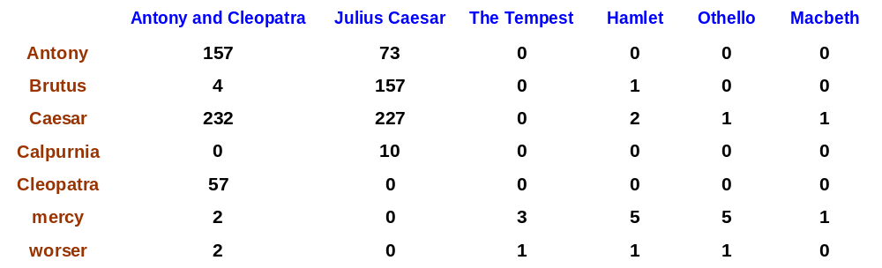
Term-document count matrices
Sec. 6.2
Consider the number of occurrences of a term in a document:
  Each document is a count vector in ℕ^{v}: a column below

Slide 18
Bag of words model
Vector representation doesn’t consider the ordering of words in a document
John is quicker than Mary and Mary is quicker than John have the same vectors
This is called the bag of words model.
In a sense, this is a step back: The positional index was able to distinguish these two documents.
We will look at “recovering” positional information later in this course.
For now: bag of words model

Slide 19
Term frequency tf
The term frequency tf_{t,d} of term t in document d is defined as the number of times that t occurs in d.
We want to use tf when computing query-document match scores. But how?
Raw term frequency is not what we want
  A document with 10 occurrences of the term is more relevant than a document with 1 occurrence of the term.
  But not 10 times more relevant.
Relevance does not increase proportionally with term frequency.

Slide 20
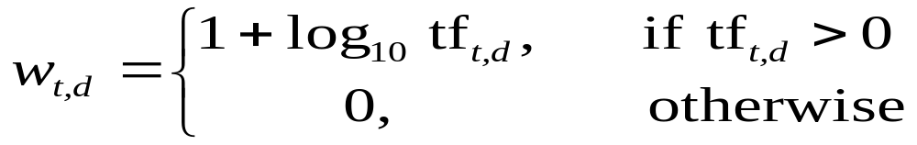

Log-frequency weighting
Sec. 6.2
The log frequency weight of term t in d is
0 → 0, 1 → 1, 2 → 1.3, 10 → 2, 1000 → 4, etc.
How will you compute Score for a document-query pair:
sum over terms t in both q and d:
score
The score is 0 if none of the query terms is present in the document.

Slide 21
Document frequency
Sec. 6.2.1
Rare terms are more informative than frequent terms
  Recall stop words
Consider a term in the query that is rare in the collection (e.g., arachnocentric)
A document containing this term is very likely to be relevant to the query arachnocentric
→ We want a high weight for rare terms like arachnocentric.

Slide 22
Document frequency, continued
Sec. 6.2.1
Frequent terms are less informative than rare terms
Consider a query term that is frequent in the collection (e.g., high, increase, line)
A document containing such a term is more likely to be relevant than a document that doesn’t
But it’s not a sure indicator of relevance.
→ For frequent terms, we want high positive weights for words like high, increase, and line
But lower weights than for rare terms.
We will use document frequency (df) to capture this.

Slide 23
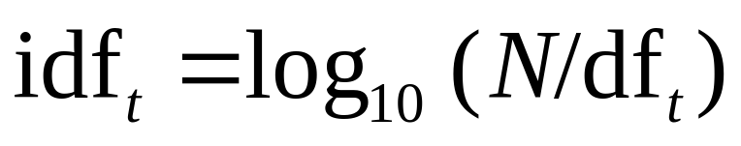
idf weight
Sec. 6.2.1
df_{t} is the document frequency of t: the number of documents that contain t
  df_{t} is an inverse measure of the informativeness of t
  What can be the max value of df_{t}
  df_{t} ≤ N
We define the idf (inverse document frequency) of t by
  Why We use log (N/df_{t}) instead of N/df_{t}
  to “dampen” the effect of idf.
Will turn out the base of the log is immaterial.

Slide 24

Mathematically the base of the log function does not
matter and constitutes a constant multiplicative factor
towards the overall result.

Slide 25
idf example, suppose N = 1 million
Sec. 6.2.1
term | df_{t} | idf_{t}
calpurnia | 1 | ?
animal | 100 | ?
sunday | 1,000 | ?
fly | 10,000 | ?
under | 100,000 | ?
the | 1,000,000 | ?
There is one idf value for each term t in a collection.
Notes:
6 4 3 2 1 0

Slide 26
idf example, suppose N = 1 million
Sec. 6.2.1
term | df_{t} | idf_{t}
calpurnia | 1 | 6
animal | 100 | 4
sunday | 1,000 | 3
fly | 10,000 | 2
under | 100,000 | 1
the | 1,000,000 | 0
There is one idf value for each term t in a collection.
Notes:
6 4 3 2 1 0

Slide 27
Effect of idf on ranking
Does idf have an effect on ranking for one-term queries, like
  iPhone
idf has no effect on ranking one term queries
  idf affects the ranking of documents for queries with at least two terms
  For the query capricious person, idf weighting makes occurrences of capricious count for much more in the final document ranking than occurrences of person.

Slide 28
So for a term one query, you're going to have one of these terms of N over
the document frequency, and it'll be worked out. But it's going to be just a
scaling factor. Which, since there's only one IDF value for each term will be
applied to every document, and therefore, it won't affect the ranking in
any way. You only get an effect from IDF when you have multiple-terms
in a query. So, for example, if we have the query, capricious person,
well, now, we're in a situation where capricious is a much rarer word.
And so IDF will say. Pay much more attention to documents that
contain the word capricious, than to documents that contain just the word
person in ranking your retrieval results.

Slide 29
Collection vs. Document frequency
Sec. 6.2.1
The collection frequency of t is the number of occurrences of t in the collection, counting multiple occurrences.
Example:
Which word is a better search term (and should get a higher weight)?
What does it mean
Word | Collection frequency | Document frequency
insurance | 10440 | 3997
try | 10422 | 8760
Notes:
Why do you get these numbers?
Suggests df is better.

